Slide 1
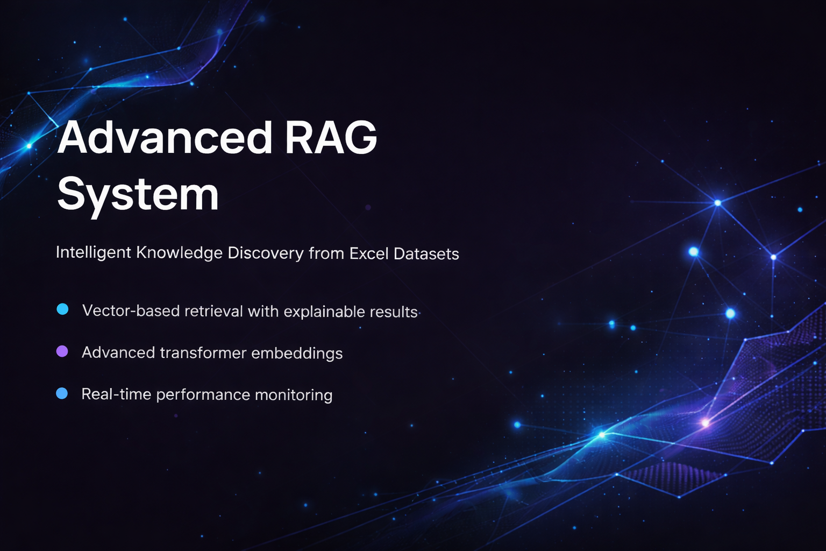
Internship Organization: Bits N' Bytes Cybersecurity Education, USA
Prepared By: Devadharshani B Trainer: Vidya Bharadwaj
February 2026 – March 2026

Slide 2


Project Introduction
Use of Retrieval-Augmented Generation (RAG)
Core Project Overview
Advanced RAG-Enabled Transformer Embedding System designed for intelligent knowledge discovery and analysis from Excel datasets efficiently.
The system integrates Retrieval-Augmented Generation (RAG) and transformer embeddings to retrieve relevant information from structured data.
Semantic Vector Embeddings Dataset rows are converted into semantic vector embeddings and stored in a FAISS vector database for efficient similarity search.
AI-Based Data Interaction The project develops an AI-based system that allows users to interact with Excel datasets using natural language queries.
Simplified Data Analysis The project aims to simplify data analysis by enabling users to discover insights from large datasets through an intelligent and user-friendly interface.

Slide 3
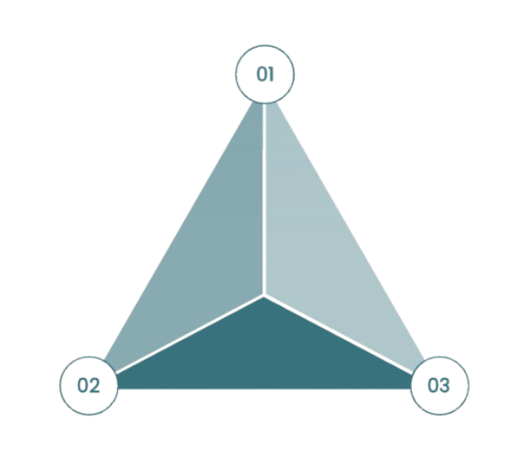
Problem Statement & Solution
User Limitations
Non-technical users unable to analyze complex datasets efficiently using traditional spreadsheet methods and tools.
Proposed Solution
AI-powered RAG system enables natural language queries with semantic embeddings, FAISS database, and intelligent retrieval capabilities.
Current Challenges
Large Excel datasets lack accessibility; manual extraction requires technical queries, consuming excessive time and effort for analysis.

Slide 4
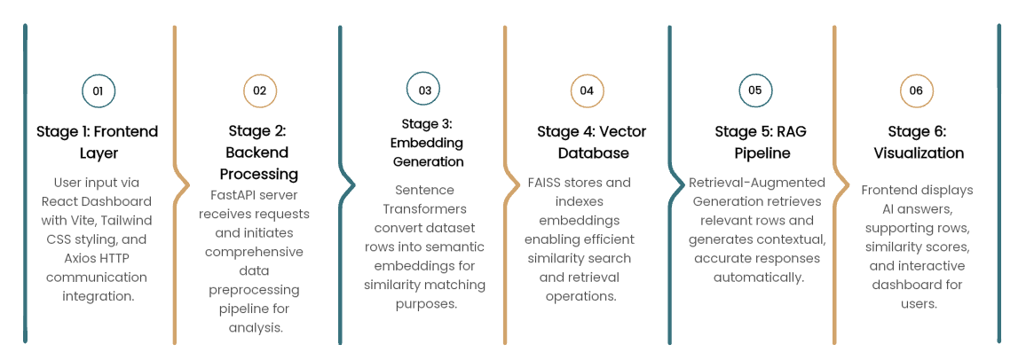
System Architecture & Tech Stack

Slide 5

Implementation Workflow & Outputs
Upload Excel dataset through frontend interface for processing and system integration.
Step 2: Data
Preprocessing
Preprocess dataset rows and convert to textual format for embedding generation.
Step 1: Data Ingestion
Step 3: Embedding Generation
Generate embeddings using transformer model, specifically Sentence-BERT architecture.
Step 4: Vector Storage
Store embeddings in FAISS vector database for efficient indexing and retrieval.
Accept natural language query from user through interactive dashboard interface.
Step 6: Similarity Retrieval
Retrieve relevant rows using similarity search and ranking algorithms.
Step 5: Query Input
Generate AI response using RAG pipeline with supporting dataset rows and scores.
Provide AI-generated answers, supporting rows, similarity scores, and interactive visualization dashboard.
Step 7: Response Generation
Output Delivery

Slide 6
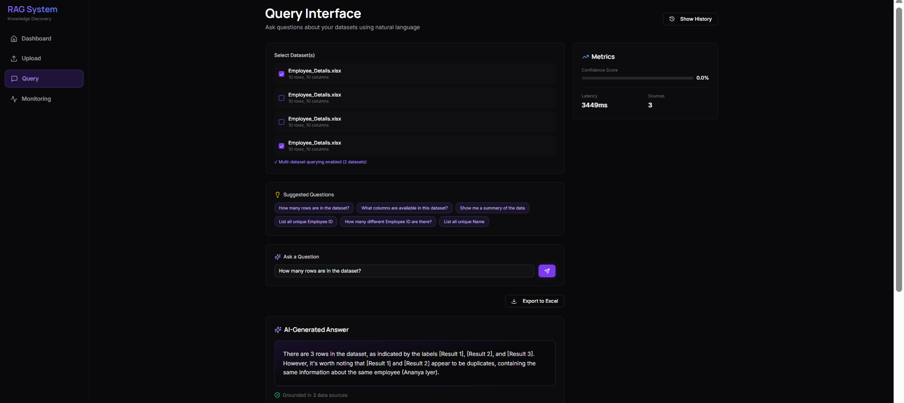
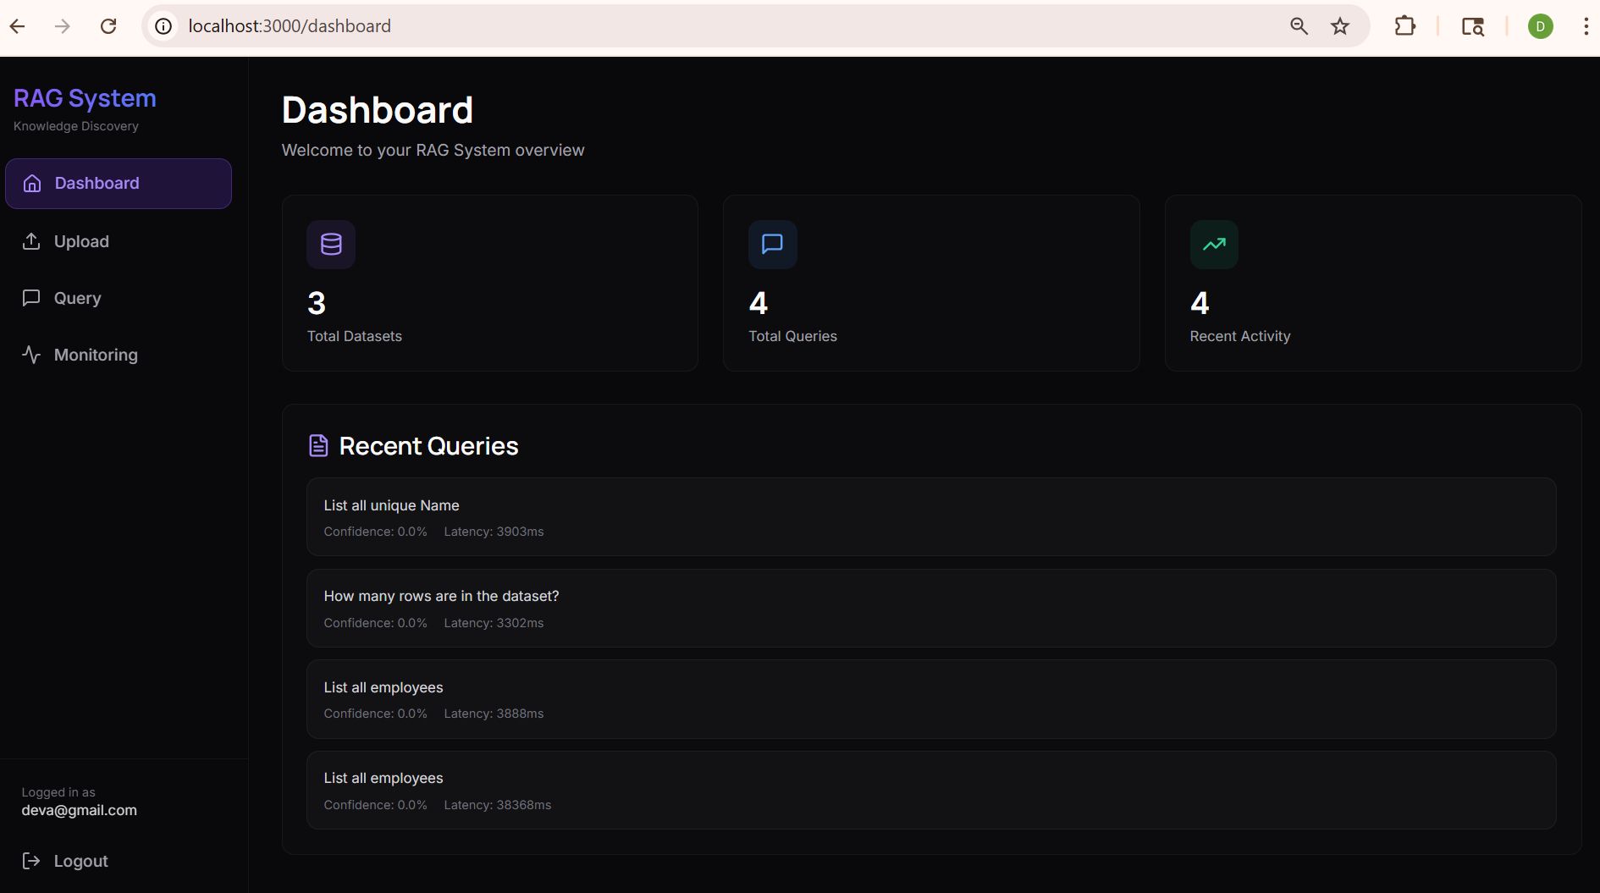
Deployment & Links
Output Screenshots:
GitHub Repository
The complete implementation of this project is available on GitHub.
Repository Link: https://github.com/Devadharshani13/RAG-Enabled-Transformer-Embedding-System-for-Intelligent-Knowledge-Discovery-from-Excel-Datasets
Recording Link:
https://drive.google.com/drive/folders/162DS-9GO93HZHb6BsHi2iREF2oodOkbz?usp=sharing

Slide 7
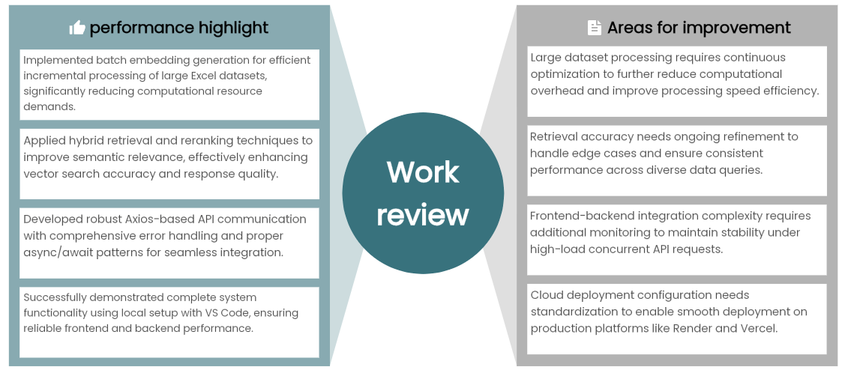
Challenges & Solutions Overview

Slide 8





Feasibility, Impact & Research Foundation
Feasibility
Impact & Benefits
Research Foundation
Key Achievement
Leverages open-source AI technologies with minimal infrastructure requirements and scalable architecture for future cloud deployment.
Reduces manual effort by eighty percent, improves decision-making through instant insights, democratizes data access for non-technical users.
Built on Retrieval-Augmented Generation, Sentence-BERT embeddings, and FAISS Vector Search providing state-of-the-art retrieval capabilities.
Demonstrates practical application of transformer embeddings and vector databases in real-world enterprise data analysis scenarios.

Slide 9
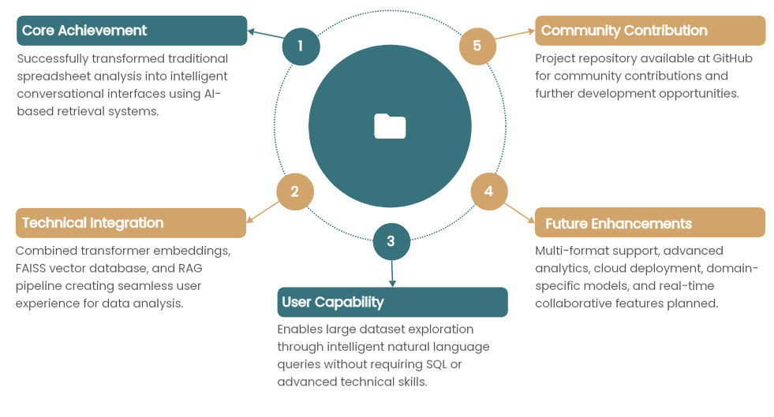
Conclusion & Future Outlook

